Slide 1

The Internet for All – Inclusive Research

Slide 2
Web Standards
HTML is designed for universal access
“The power of the Web is in its universality. Access by everyone regardless of disability is an essential aspect.” - Tim Berners-Lee, director of the Word Wide Web Consortium and inventor of the World Wide Web.

Slide 3
Who’s Excluded?
Internet only – accessibility/skill/inclination
Landline Survey – No landline, Deaf
Print Only – Print Disabled
Check your process – only hard copy good enough for sign up?

Slide 4
Contrast, font and size
This is too light – although the second part is better
Better but still not good
This is much better
Hard to see?
Much easier
Probably not the easiest font
Good old sans serif Arial
STILL NOT SO GOOD – CAPS ARE HARD TO READ
And this is better still ☺

Slide 5
Use of Multiple Sensory Characteristics
Use of colour, or sound, alone to convey meaning.
John Smith or John Smith FAIL
Fred Jones Fred Jones PASS

Slide 6
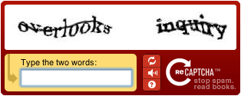
Turing Might Have Tried too Hard
Avoiding SPAM is important
Avoiding users is more so
Don’t use CAPTCHA

Slide 7
Structure
Logical
Consistent
Headings Clear

Slide 8
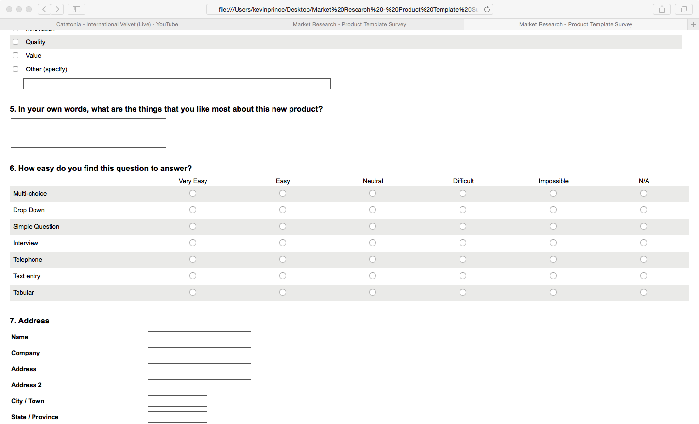
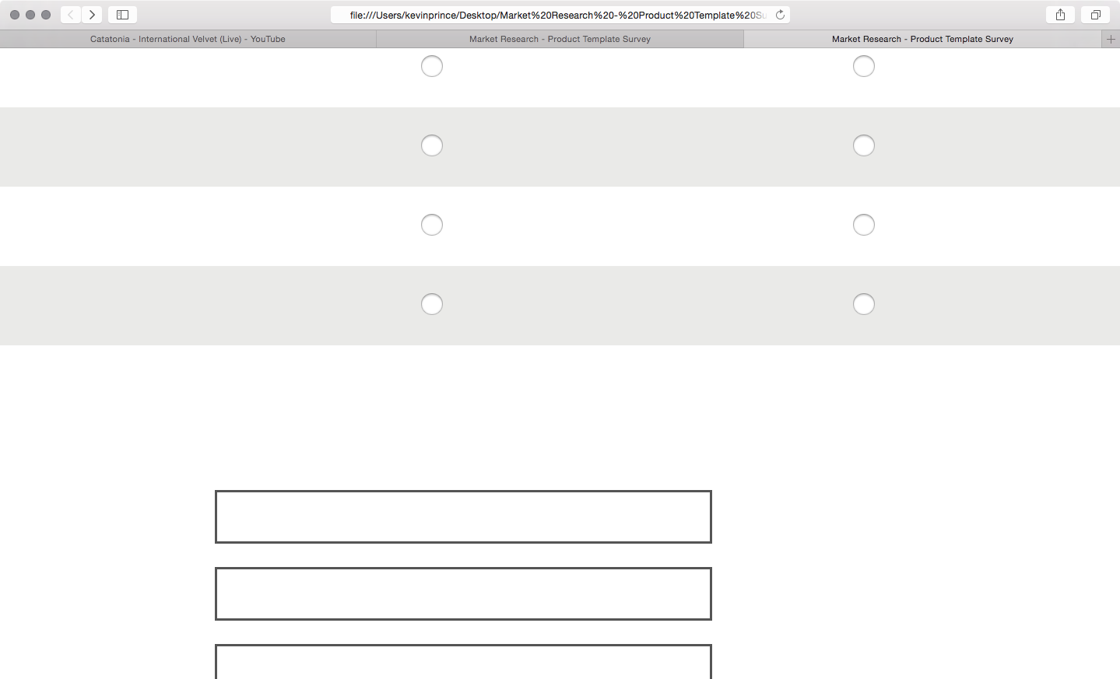
Magnification: What can I see in one go.

Slide 9
Documents
Fonts
Images
Links
Tables
Headings
http://blindfoundation.org.nz/learn/accessible-information/accessible-documents

Slide 10
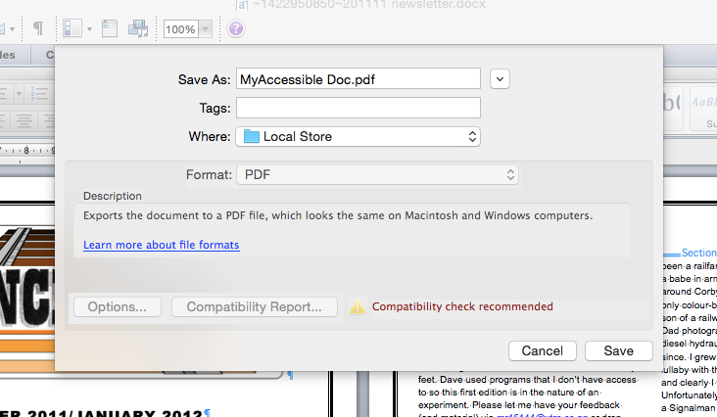
Documents 2
Word 2010 – Accessibility Checker
Create simple pdf from Word

Slide 11
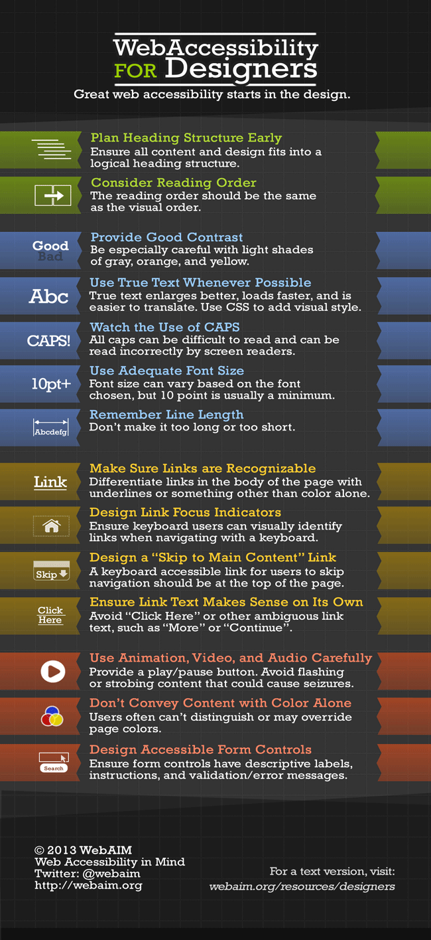
Great resources
webaim.org/resources/designers
http://webaim.org/resources/quickref/
Note – text and infographic options
http://wave.webaim.org/

Slide 12
Thank You and Questions
Kevin Prince
kevin@access1in5.co.nz
021 2220638

